Slide 1

Small
Business
Test

Slide 2

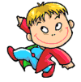

Instructions
1. Read the question
2. Choose the most correct answer
3. Record your answer on the Answer Sheet
4. Click to move to the next question

Slide 3
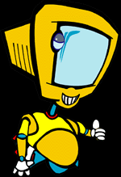
Question 1
What is a Small Business?
A
An independently owned business with less than 20 employees
C
A business that earns less than $100,000 in revenue
B
A business that has only 2 branches

Slide 4

Question 2
What is Profit?
A
Money a business earns through sales
B
When Revenue is greater than Expenses
C
Revenue minus Expenses

Slide 5

Question 3
What is a Partnership?
A
A business where the staff work as a team
B
A form of business that can sell shares privately
C
A form of business that is made up of 2 or more owners

Slide 6
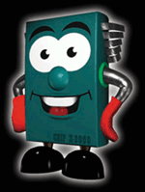
Question 4
What is Marketing?
A
Advertising and other promotional techniques
C
Managing your business to do what your customers want when they want it for mutual benefit
B
Being able to attract customers and close a sale

Slide 7
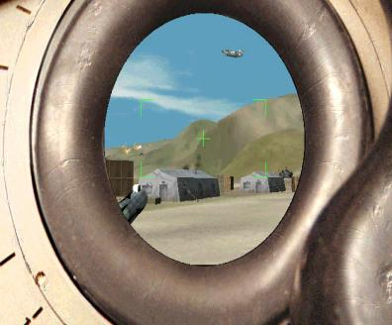
Question 5
What are the three stages of
consumer behaviour?
A
Buy
Use
Satisfaction
C
Desire
Demand
Sale
B
Investigate
Trial
Consume

Slide 8
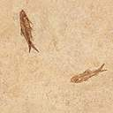
Question 6
What are the 4 P’s in the
Marketing Mix?
A
Product
Price
Place
Promotion
C
Promotion
Publicity
Profit
People
B
Purchase
Package
People
Product

Slide 9

Question 7
What is Promotion?
A
When you are awarded a higher position
C
Techniques to distribute your product
B
Strategies to increase desire, demand and sales

Slide 10

Question 8
What is an advantage of Publicity?
A
It has a high level of credibility
C
It is very costly
B
It involves paid advertising

Slide 11
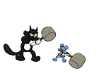
Question 9
Choose a disadvantage of
Personal Selling.
A
Costly and difficult to organise and manage a team of sales staff
C
The customer has face to face contact with product experts
B
Able to resolve any objections on the spot

Slide 12

Question 10
Name a stage in the
Small Business lifecycle.
A
Failure
C
Produce
B
Consolidation

Slide 13
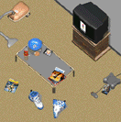
Question 11
What helps you to plan and control cash?
A
Bank Statement
C
Cash Flow Forecast
B
Profit and Loss Projection

Slide 14
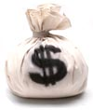
Question 12
What is a Micro Business?
A
A business with less than 5 employees
C
A business that specialises in microchips
B
One that earns less than $50,000 revenue in a year

Slide 15

Question 13 choose the best strategy
You have an employee in your business that works well and
is always on time but is very quiet, eats his lunch at his desk and
never goes to staff social functions.
What do you?
A
Nothing. The important thing is that he is a good worker
C
Have a chat with him to see if there is something that has upset him
B
Sack him. You want a workplace where everyone is friends

Slide 16
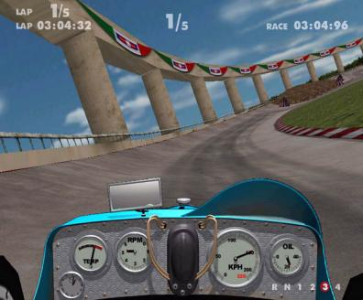
Question 14 choose the best strategy
You have a staff member that is an OK worker but other staff have
come to you to say that he makes offensive jokes and comments.
You have heard some yourself.
What do you?
A
Run an education campaign about tolerance and workplace harassment
C
Talk to him privately and tell him about the complaints
B
Nothing. You think the other staff should get a sense of humour

Slide 17
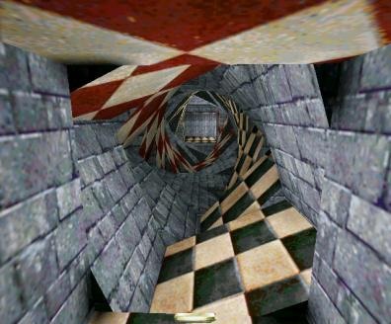
Question 15 True or False
To succeed in business it is necessary
to have some degree of dishonesty.
True
False

Slide 18

You have completed
the test!

