Slide 1
Chapters 14 and 16
Hip hop, and electronic dance music

Slide 2
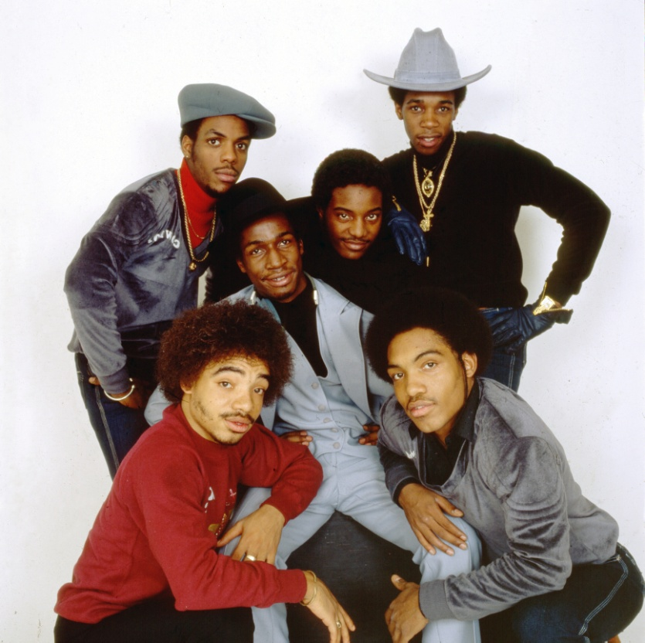
Hip hop
In America, a new style had been slowly gathering momentum from the mid-1970s. Known as hip hop, the music featured a DJ playing song samples on a turntable and an MC chanting accompanying rhythmic verses in a style known as rapping. The first mainstream rap hit was ‘The Message’ by Grandmaster Flash & the Furious Five (pictured right).
Getty Images/Anthony Barboza

Slide 3
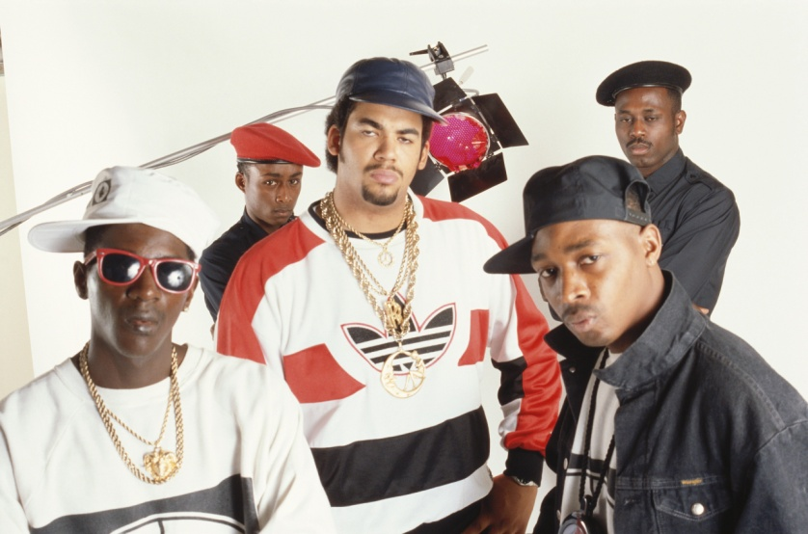
Public Enemy
Many rap songs contained strong political messages, and this style was epitomised by groups such as Public Enemy (pictured right).
Getty Images/Michael Ochs Archives

Slide 4
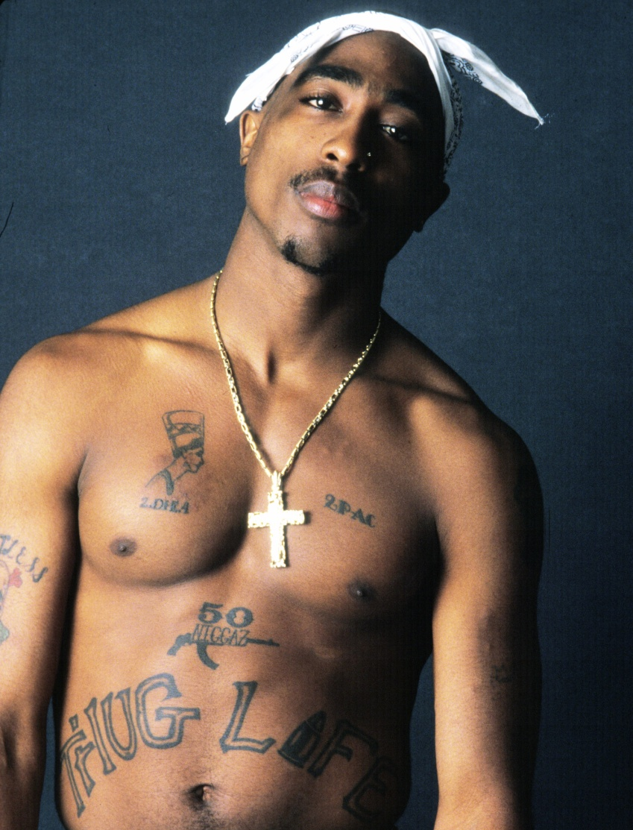
Gangsta
In the 1990s, intense rivalry generated by a violent form of rap called gangsta and fuelled by the media led to the deaths of Notorious B.I.G. and Tupac Shakur (pictured right). Tupac had enjoyed particular success with songs such as ‘Changes’.
Corbis/Chi Modu/Diverse Images

Slide 5

Snoop Dogg
A hip hop artist who has enjoyed great success but is not without his share of controversy is Snoop Dogg (pictured right). Criticised for misogynous and often violent lyrics, Snoop Dogg almost croons his raps in a semi-melodic manner.
Shutterstock.com/Everett Collection

Slide 6

Hip hop subculture
Hip hop has given rise to its own distinctive subculture. This includes breakdancing, fashion, language and more.
Corbis/Ocean

Slide 7

Hip hop in Australia
Although hip hop not has not been as popular with Australian artists, the Hilltop Hoods (pictured right), from Adelaide, have enjoyed considerable success. They attribute music to having ‘saved’ their lives, and they have been prominent in supporting new and emerging Australian hip hop artists.
Hilltop Hoods

Slide 8

Eminem
One of the few white artists to succeed in hip hop is Eminem (pictured right). A controversial figure, he is noted for the lyrical nature of his lyrics and his subtle changes of rhythm in his delivery.
Shutterstock.com/Featureflash

Slide 9

Electronic dance music
Another form of popular music that emerged in the 1980s was electronic dance music. Many electronic dance music producers point to the 1983 song ‘Blue Monday’ by New Order (pictured right) as the immediate source of this style.
Alamy/Pictorial Press Ltd

Slide 10
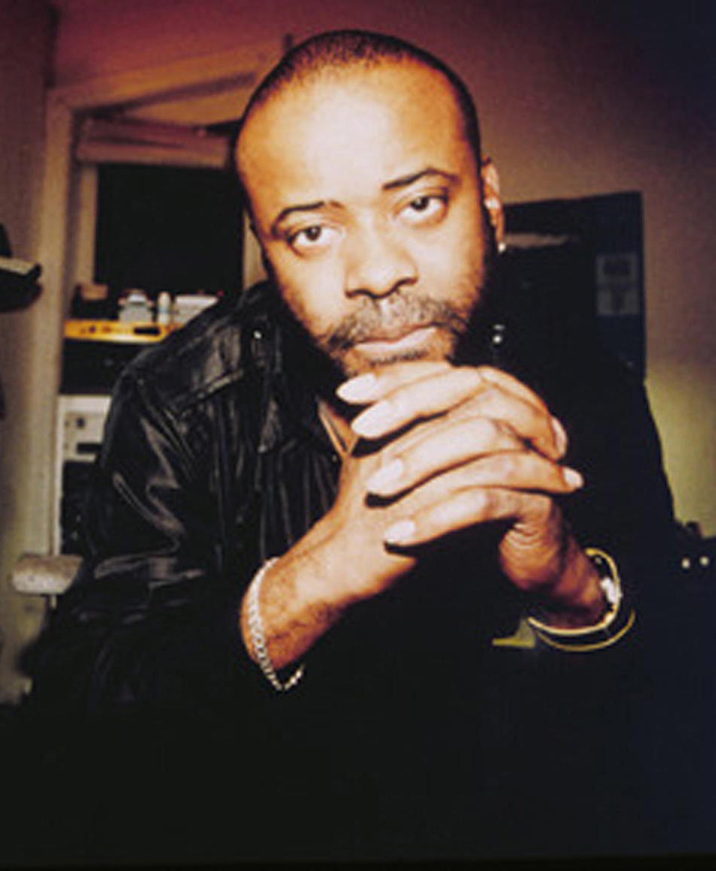
Techno
Electronic dance music, often known as house music, began in Chicago at the Warehouse disco. However, the music soon spread and diversified. Juan Atkins (pictured right) formed the group Cybotron to create a hard edged industrial sound effects style called techno, exemplified in the song ‘Techno City’.
AAP/AP Photo/Juan Atkins

Slide 11
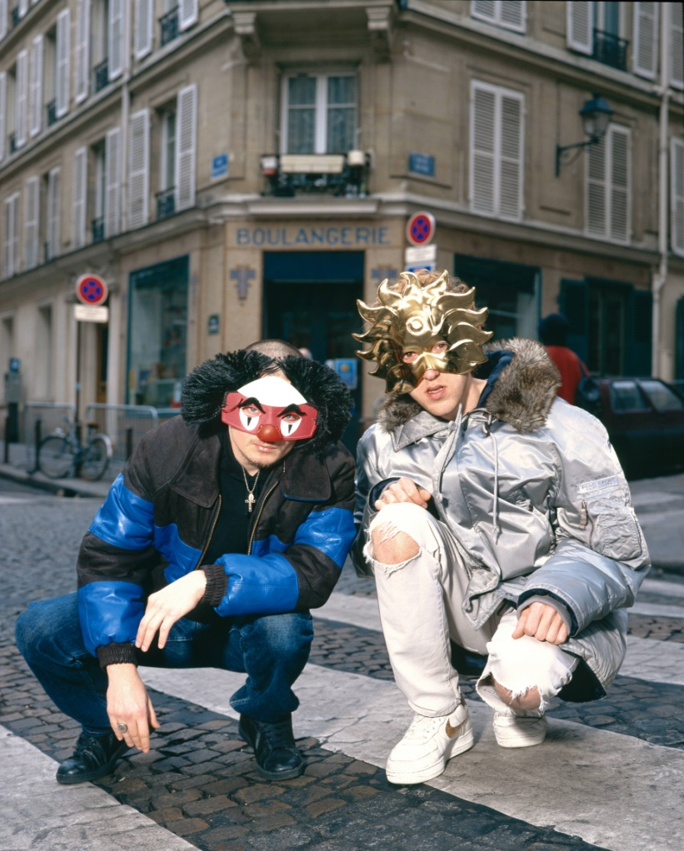
House music
House music is often created live in dance venues and does not always translate well to the radio or recorded music mediums. However, one of the few commercially successful house groups has been the French duo Daft Punk (pictured right). Songs like ‘Technologic’ are typical of their style.
Getty Images/Redferns/Mick Hutson

Slide 12

Classical music inspiration
Like some progressive rock artists, some house producers have turned to classical music for inspiration. One of the more successful has been William Orbit (pictured right) with his album Pieces in a Modern Style, and the song ‘Adagio For Strings’.
Getty Images/Victor Fraile

Slide 13
Evolution of House
House music continues to evolve and is one of the more unusual and futuristic sounding popular musical styles. Its proponents state that the music needs to be listened to in different ways to fully appreciate it.

