Slide 1
Chapters 13 and 15
Australian pub rock, and Indigenous rock

Slide 2
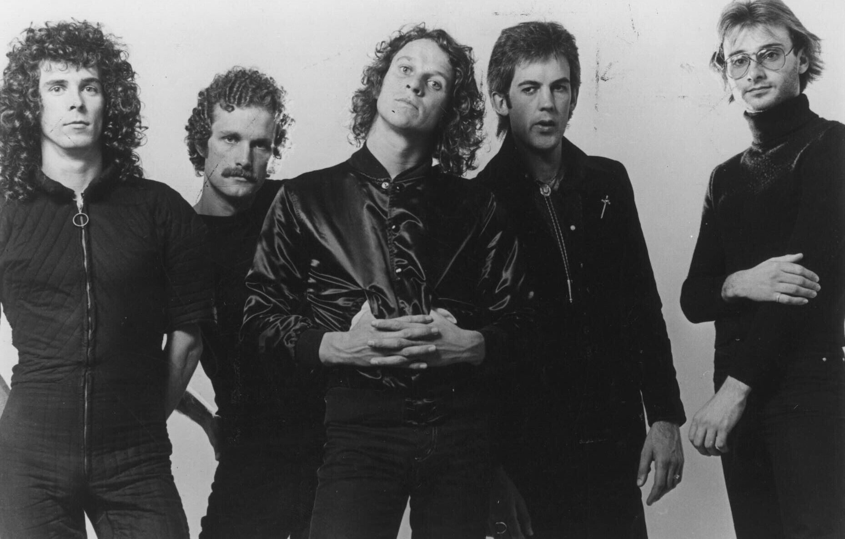
Australian pub rock
An Australian identity in popular music began to emerge in the early 1970s largely through bands like Skyhooks (pictured right). They sang songs about Australian places and Australian characteristics, and fuelled one of Australia’s great rivalries with glam band Sherbet.
Newspix/News Ltd

Slide 3

Nick Cave
Other Australian artists emerged into the international spotlight, including the eclectic and multi-talented Nick Cave (pictured right).
Getty Images/Michael Ochs Archives

Slide 4
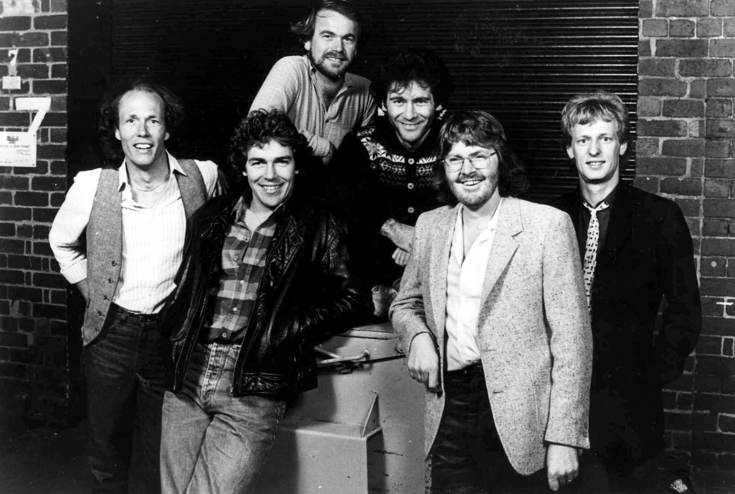
Little River Band
Little River Band (pictured right) was formed to deliberately break into the American country rock market. They were hugely successful with relaxed close harmony songs such as ‘Cool Change’.
Newspix/News Ltd

Slide 5
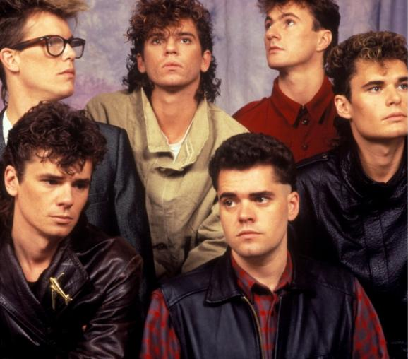
INXS
Another Australian band to break through internationally was INXS (pictured right). Led by the flamboyant Michael Hutchence, INXS enjoyed massive success throughout the 1980s with songs such as ‘Tear Us Apart’.
Getty Images/Hulton Archive

Slide 6
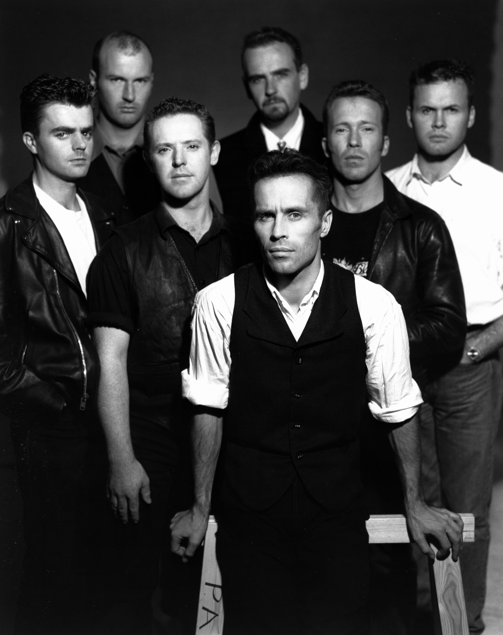
1980s pub rock
One reason attributed to the success of Australian bands in the 1980s was a healthy pub and club scene. Bands honed their craft in the pubs and clubs playing old fashioned hard rock at a time when the rest of the world was listening to synth-pop. The pub rock sound was epitomised by Hunters and Collectors (pictured right).
Mushroom Group

Slide 7
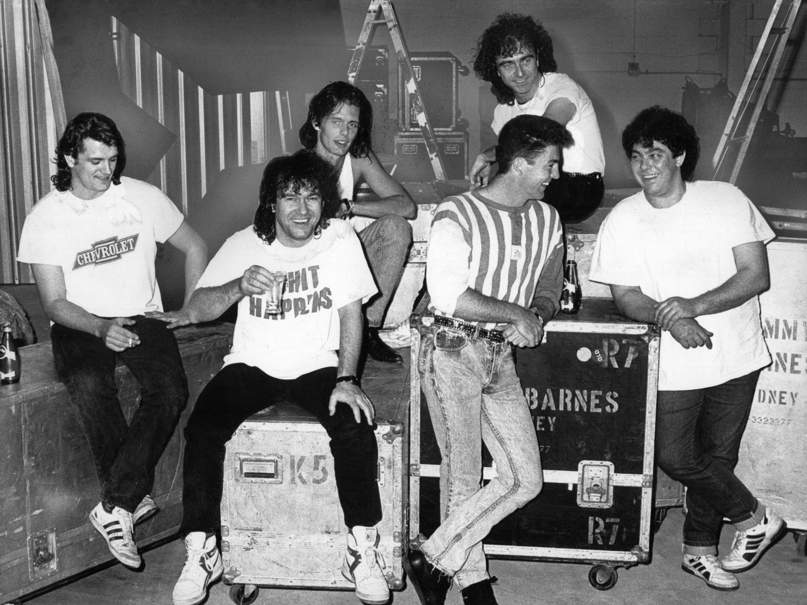
Cold Chisel
Another successful local band was Cold Chisel. Led by hard living front man Jimmy Barnes, Cold Chisel (pictured right) enjoyed hits with songs such as ‘Khe Sanh’ which told the story of the struggles of a restless returned Vietnam Veteran.
Newspix/News Ltd

Slide 8

‘Unplugged’
Australian artists also pioneered a new trend called ‘unplugged’ whereby they sang their songs to acoustic accompaniment only. One of these was Mark Seymour (pictured right), lead singer of Hunters and Collectors.
Getty Images/Lucas Dawson

Slide 9
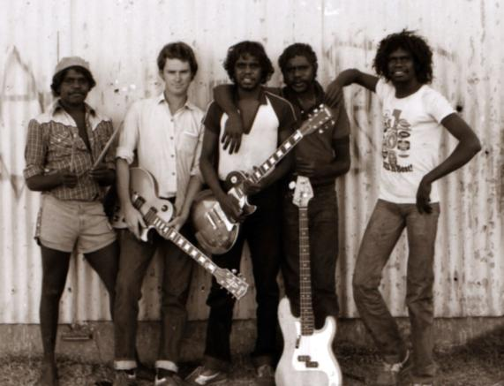
Indigenous Australian rock
This period also saw the rise of Indigenous Australian rock. The creation of the Central Australian Aboriginal Media Association (CAAMA) in the 1980s helped promote Indigenous bands from a wide variety of communities through central Australia. One of the most successful was Warumpi Band (pictured right) with songs such as ‘Black Fella, White Fella’.
Photo courtesy of Neil Murray, Island Home Music Pty Ltd

Slide 10
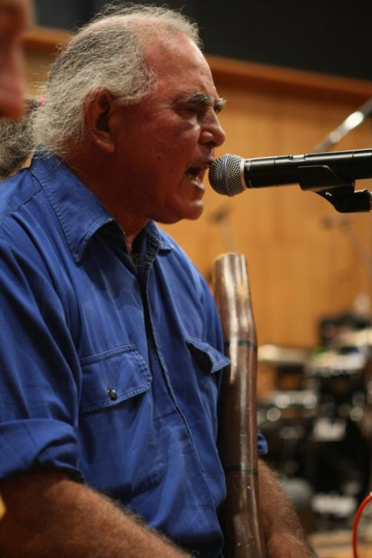
Kev Carmody
Another politically active singer songwriter was Kev Carmody (pictured right), who, along with Paul Kelly, immortalised the Wave Hill Cattle Station strike in the 1960s in his sing ‘From Little Things, Big Things Grow’.
Newspix/Troy Bendeich

Slide 11
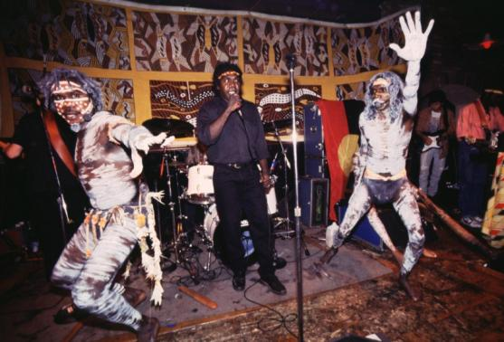
Yothu Yindi
However, the most internationally successful Australian Indigenous band has been Yothu Yindi (pictured right). From Arnhem Land, the band has combined traditional Yolingu musicians with balanda Western musicians. They achieved great success with their song ‘Treaty’.
Getty Images/Steve Eichner

Slide 12
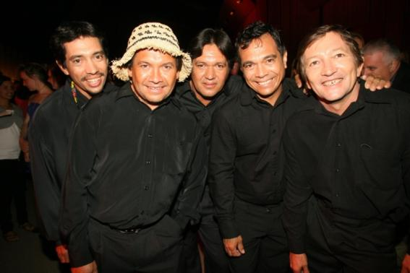
Pigram Brothers
Broome in Western Australia is also the home of a number of noted Indigenous musicians, including the Pigram Brothers (pictured right). Steven Pigram had a hit with his song ‘Where I B’long’.
Newspix/Justin Lloyd

Slide 13

Archie Roach
Arguably the most poignant and personal Indigenous artist is Archie Roach (pictured right). A member of the stolen generation, he sings simple but incredibly powerful songs about his difficult past. However, his songs such as ‘Took the Children Away’ often contain a ray of hope for the future.
Newspix/Stuart McEvoy

Slide 14
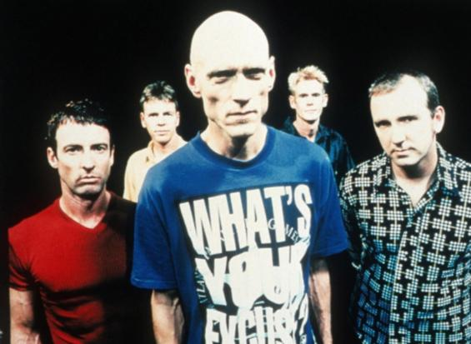
Social comment
Some white Australian bands have also tried to draw public attention to Indigenous issues. The most famous is Midnight Oil (pictured right). Although they sang protest songs about many issues, one of their most successful was ‘Beds Are Burning’ about the displaced Pintupi people.
Getty Images/AFP

Slide 15
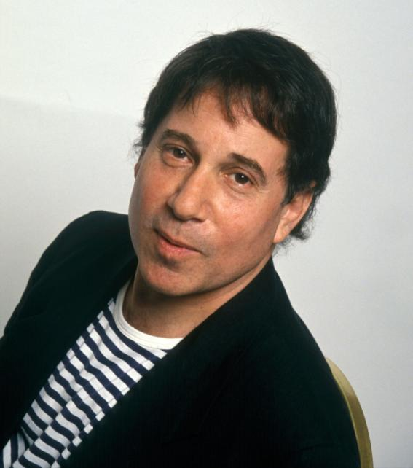
World rock
Indigenous rock is part of a wider world movement called world rock. Artists use music from different cultures to reinvigorate rock and draw attention to various world issues. Paul Simon (pictured right) enjoyed particular success with his Graceland album which incorporated the music of South Africa.
Alamy/Lewton Cole

Slide 16
Summary
Australian popular music came of age from the 1970s as Australian artists gained the courage to sing about Australia for Australians instead of copying overseas trends. The 1980s in particular was a very productive time as bands honed their craft in the pubs and clubs. It also saw the birth of Indigenous rock, as Indigenous musicians began to tell their stories.

