Slide 1
Chapters 11 and 12
Reggae, and the second British Invasion

Slide 2
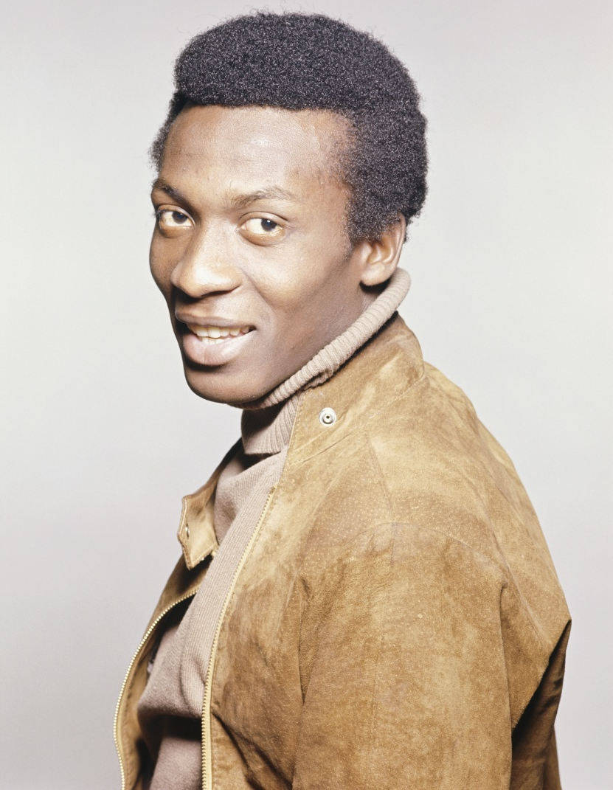
Ska
In the early 1960s, a new style of music arose in Jamaica. It took the sounds of rock’n’roll, jazz and blues, and mixed them with Jamaican mento to produce a fast but loose style called ska. A popular ska singer was Jimmy Cliff (pictured right).
Getty Images/Michael Ochs Archives

Slide 3
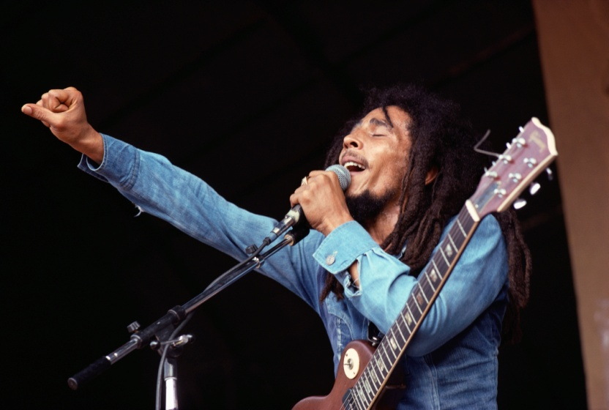
Reggae
Towards the end of the 1960s, ska began to slow down into a steadier relaxed style known as reggae. Gradually, reggae found its way into Western popular music, thanks to the efforts of Bob Marley and the Wailers (Bob Marley pictured right).
Corbis/Jeff Albertson

Slide 4

Rastafarianism
Reggae music was part of a cultural movement known as Rastafarianism. Rastas wore dreadlocks, smoked ganga and many were vegetarians. They were dedicated to obtaining political equality in Jamaica, and looked to Africa as their spiritual home.
Dreamstime.com/Lucian Coman

Slide 5
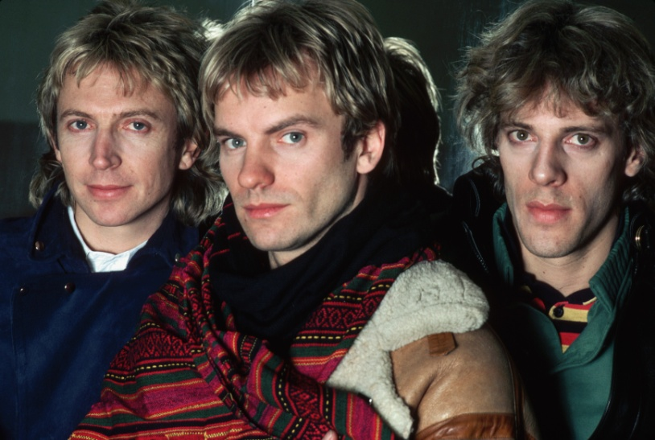
White reggae
White artists such as UB40 and The Police (pictured right) also produced reggae infused songs such as their hit ‘Roxanne’. However, they lacked the truly relaxed reggae style of Marley, and their songs were categorised as white reggae.
Corbis/Lynn Goldsmith

Slide 6
Australian reggae
Because of its political messages such as freedom from oppression, it comes as no surprise that reggae became popular with early Australian Indigenous bands such as No Fixed Address (pictured right), particularly in their song ‘We Have Survived’.
From the National Film & Sound Unit, with permission from Universal Music Australia

Slide 7

Reggaeton
Although reggae never became a strong mainstream style, it influenced many other styles. One of these was Reggaeton. Reggaeton featured reggae mixed with a rap style delivery, and was popularised by Latin performer Don Omar (pictured right).
Getty Images/Michael Caulfield Archive

Slide 8
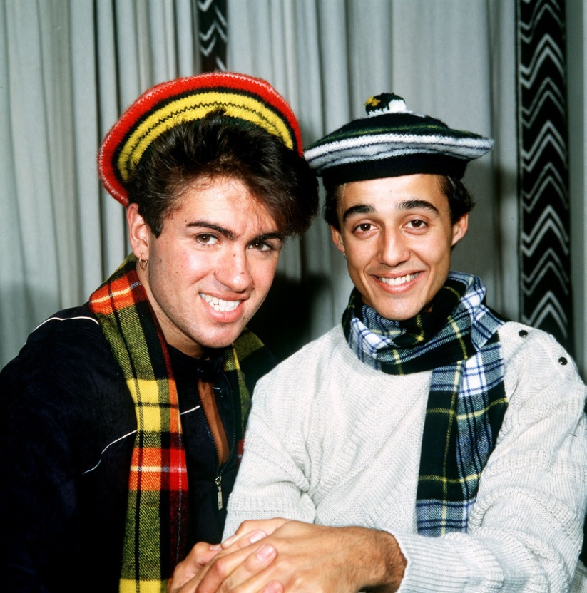
The second British Invasion
Meanwhile, from 1983, a second wave of British bands swept the world stage. These included the hugely popular group Wham (pictured right), which featured songwriter George Michael.
Alamy/Trinity Mirror/Mirrorpix

Slide 9
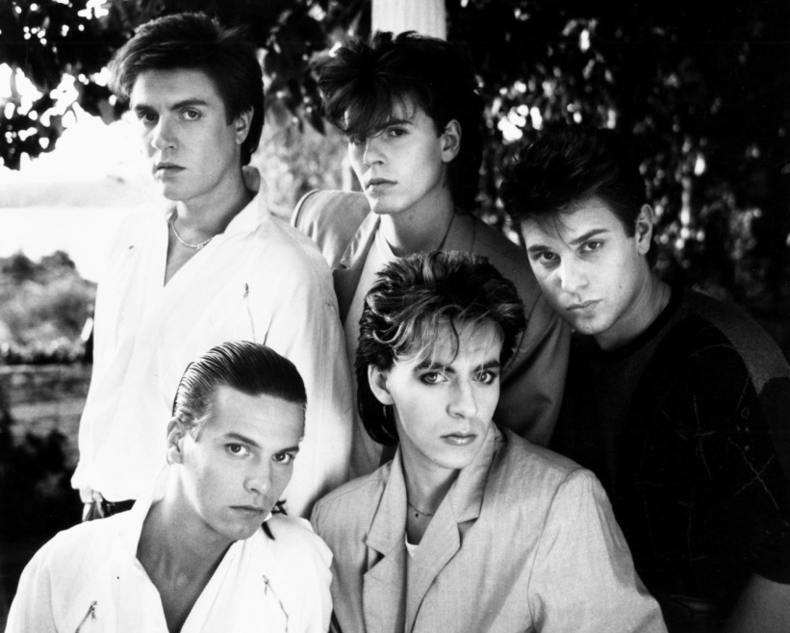
Duran Duran
Another highly successful band was Duran Duran (pictured right). They used synthesisers and a light post-disco beat, and had a big hit with ‘Hungry Like the Wolf’. Their sound became known as synth-pop.
Alamy/AF archive

Slide 10

Eurythmics
One of the most successful of the second British Invasion bands was the Eurythmics, featuring Dave Stewart and Annie Lennox. Annie Lennox had a powerful stage presence, and they had a huge hit with the heavily synthesised song ‘Sweet Dreams’.
Alamy/Pictorial Press Ltd

Slide 11
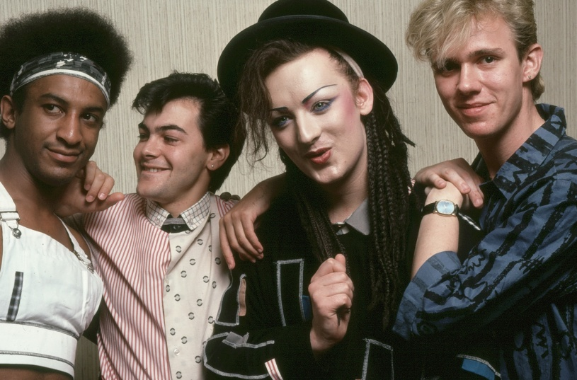
New Romantics
Some of the second British Invasion bands became known as the New Romantics. They favoured effeminate clothing and make-up, as a rebellion against the scruffy look of punk. One of the most successful was Culture Club (pictured right), led by Boy George.
Alamy/AF archive

Slide 12

Australian synth-pop
Australian artists copied the neat, heavily synthesised sound of synth-pop. John Farnham (pictured right) enjoyed a successful return to the airwaves with his album Whispering Jack, and its hit song ‘You’re the Voice’.
Newspix/Anthony Moran

Slide 13
The need for something new
The periodic international domination by British bands highlighted their natural flair for melody writing, as against the centrality of rhythm in American music. However, as the 1990s approached, a restless public yearned for something new and less overtly commercial.

