Slide 1
Chapters 5 and 6
The rise of rock music, and gospel, stax, soul, funk and disco

Slide 2
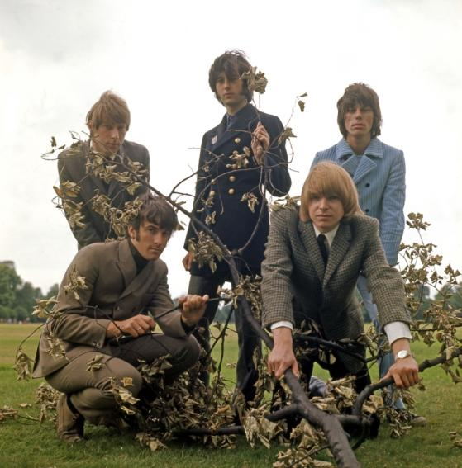
The blues in Britain
Although America abandoned the blues in the early 1960s, the blues tradition remained strong in Britain, thanks to bands such as the Yardbirds (pictured right) and the Animals. They played guitar-based blues with long solos and great energy and enthusiasm.
Alamy/Pictorial Press Ltd

Slide 3
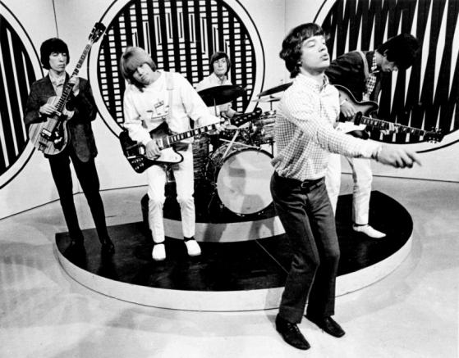
The Rolling Stones
Ultimately, the most successful blues-based band was the Rolling Stones. They deliberately cultivated a rebellious image and became the voice of angry young people through classic songs such as ‘(I Can’t Get No) Satisfaction’.
Corbis/David Farrell/Lebrecht Music & Arts

Slide 4
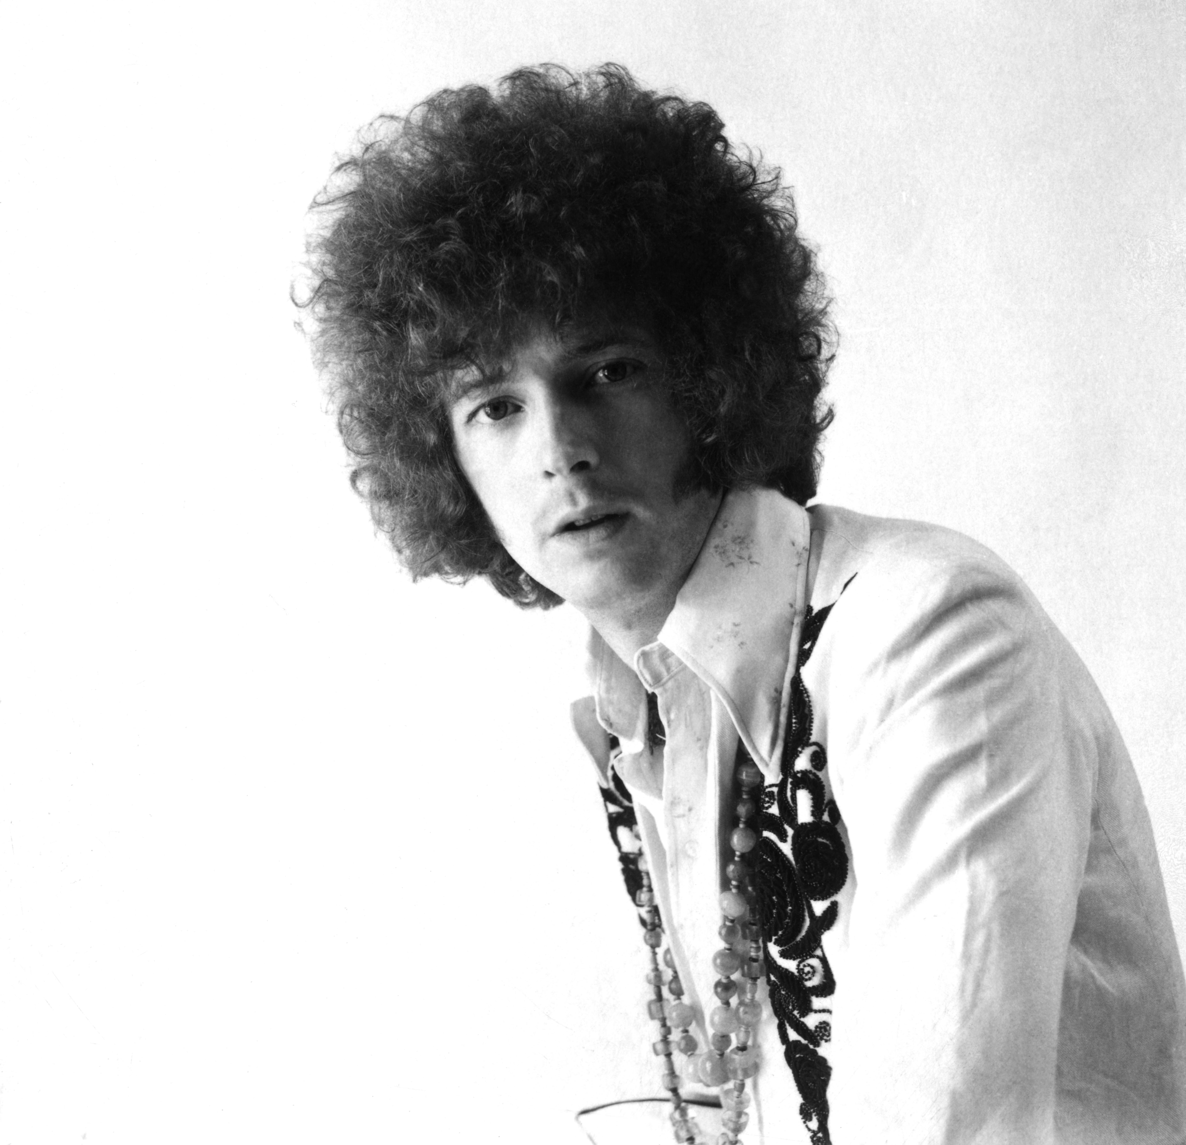
Guitar heroes – Eric Clapton
The guitar-based blues bands eventually gave rise to a series of guitar virtuosos. These players possessed amazing talent and skill, and became known as the ‘guitar heroes’. One of them was British guitarist Eric Clapton (pictured right), who started the supergroup Cream.
Alamy/Pictorial Press Ltd

Slide 5
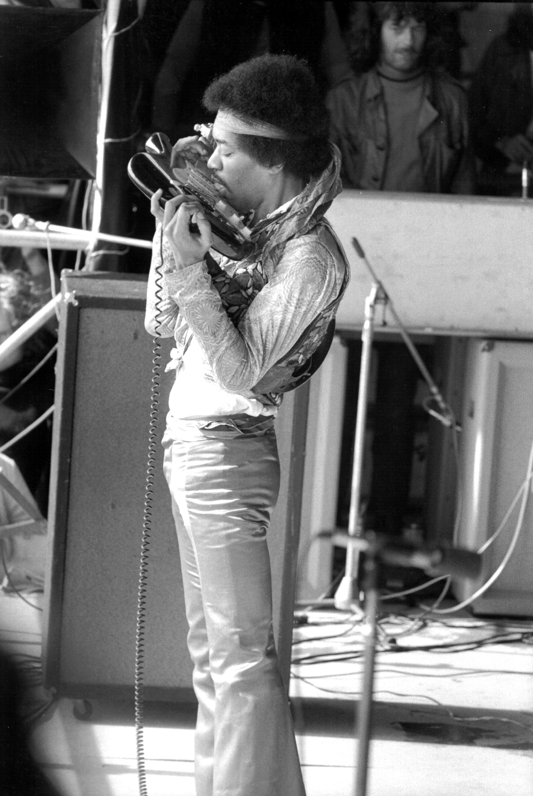
Guitar heroes – Jimi Hendrix
Another guitar hero was Jimi Hendrix, regarded by many as the greatest of them all. A phenomenal player, he could play guitar with his teeth or behind his back! Sadly, Hendrix died of a drug overdose in 1970.
Getty Images/Michael Ochs Archives

Slide 6
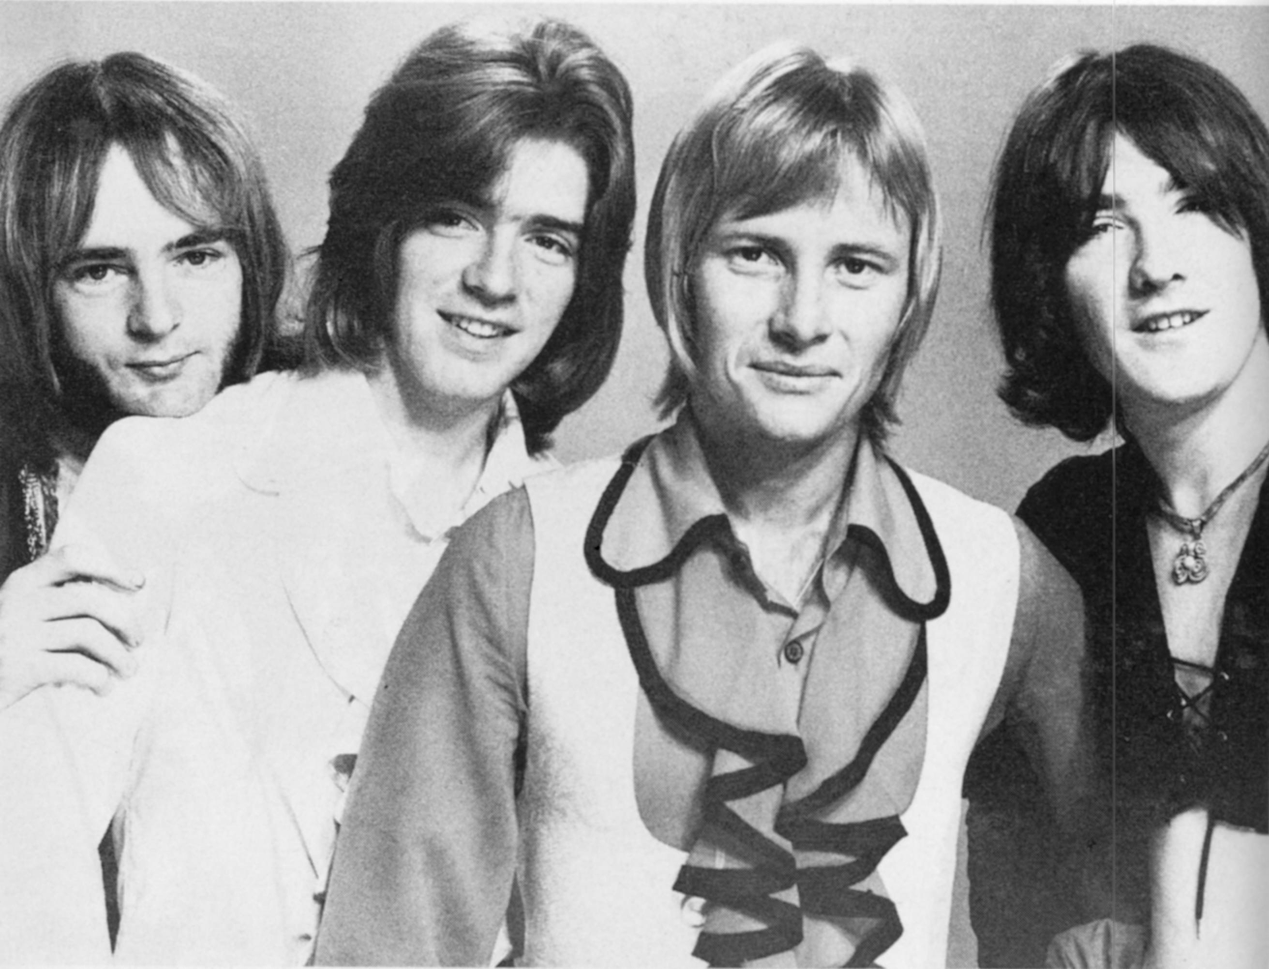
Early Australian rock
Australian bands such as the Masters Apprentices copied the hard rocking blues sound in songs such as ‘Turn Up Your Radio’.
Newspix/News Ltd

Slide 7
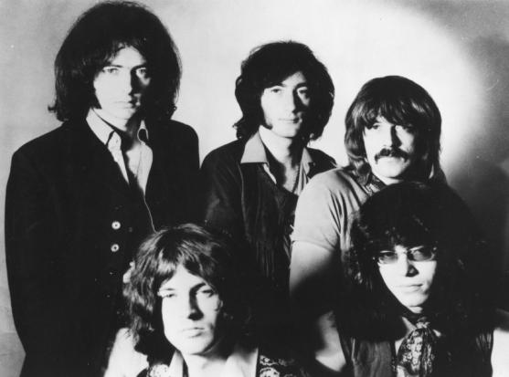
Heavy rock
The blues/rock tradition reached a peak in the early 1970s with bands such as Deep Purple (pictured right), Black Sabbath and Led Zeppelin. These bands played hard riff-based rock with lots of guitar distortion and a thumping drum beat.
The riff from Deep Purple’s ‘Smoke on the Water’ is regarded as a classic.
Alamy/Pictorial Press Ltd

Slide 8
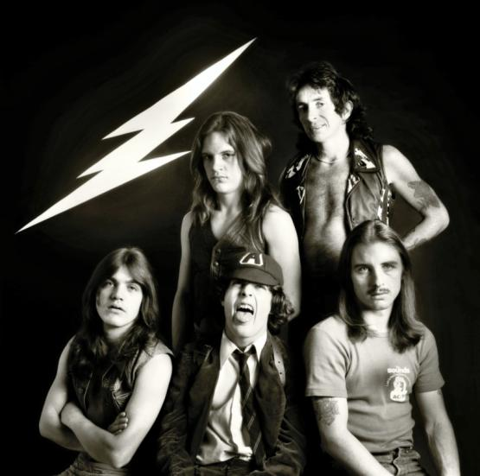
AC/DC
Again, Australian bands such as Chain played hard rock in the 1970s, but the most famous of them all was AC/DC. They have enjoyed a long and successful career, despite the early death of lead singer Bon Scott.
Corbis/Martyn Goddard

Slide 9
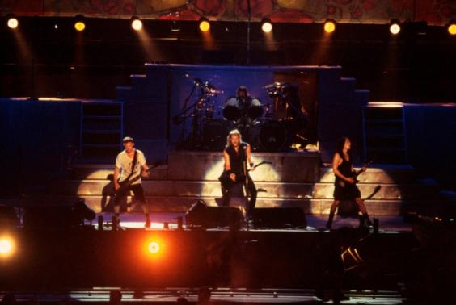
Heavy metal
Audiences were growing tired of the extended solos and theatrics of hard rock by the late 1970s. However, hard rock reinvented itself in the 1980s as heavy metal.
Thrash metal bands such as Metallica (pictured right) led the way with their high energy, full distortion, speed and brute force.
Corbis/Alexander C. Fields

Slide 10
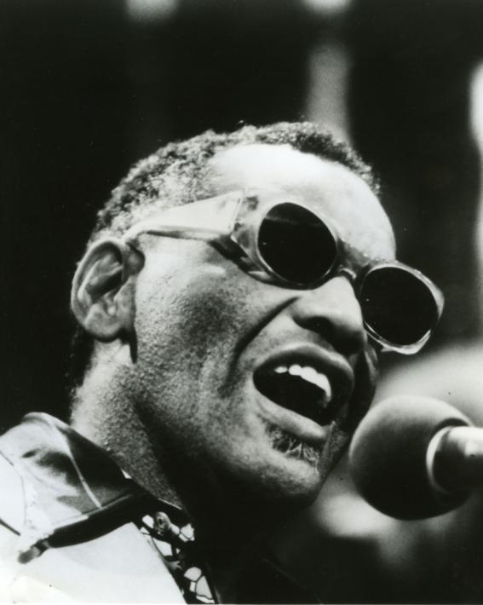
Gospel
Blues-inspired rock made a comeback in America in the mid-1960s but in a less aggressive form. American singers modelled themselves on the gospel vocal style of artists such as Ray Charles (pictured right).
Alamy/Pictorial Press Ltd

Slide 11
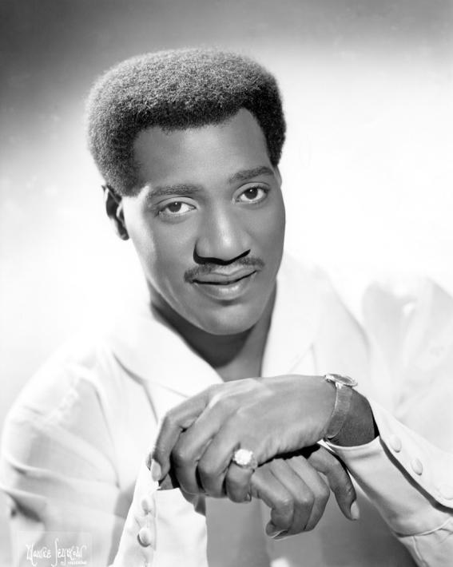
Stax
Stax Studios, located in Memphis, pioneered the sound through artists such as Wilson Pickett and Otis Reading (pictured right).
Corbis/Michael Ochs Archives

Slide 12
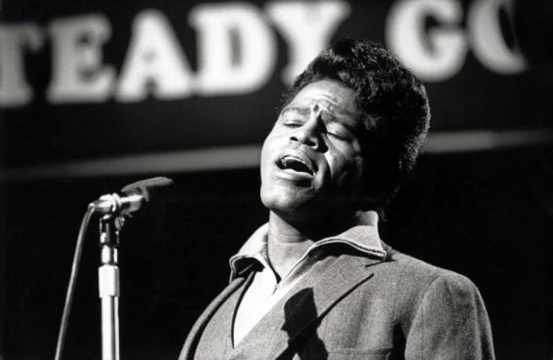
Soul
Eventually, the stax sound evolved into a wider style known as soul. The driving force behind soul was the flamboyant James Brown (pictured right), with songs such as
‘I Feel Good’. Brown was noted for his high energy stage act, impassioned vocals and thumping tight groove.
Alamy/Pictorial Press Ltd

Slide 13
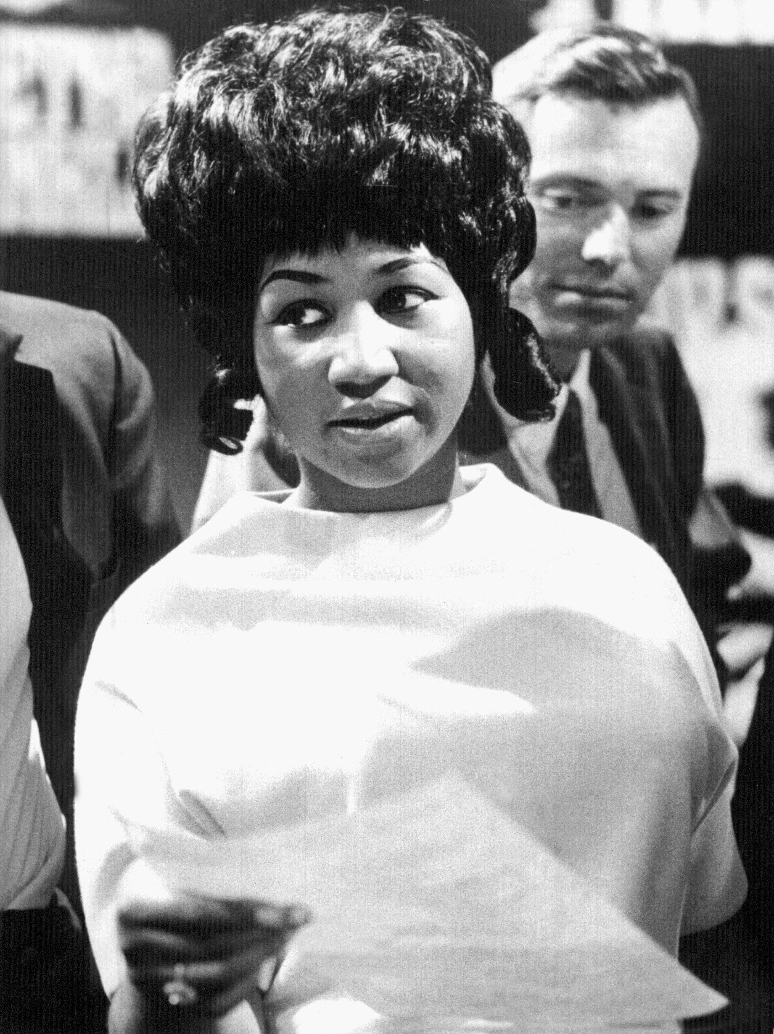
‘Soul sisters’
Female singers made an impact. Undoubtedly, the most successful was Aretha Franklin (pictured right). When she covered Otis Reading’s song ‘Respect’, it became a civil rights cry for respect for African Americans, as well as a cry for respect for women.
Corbis/dpa

Slide 14
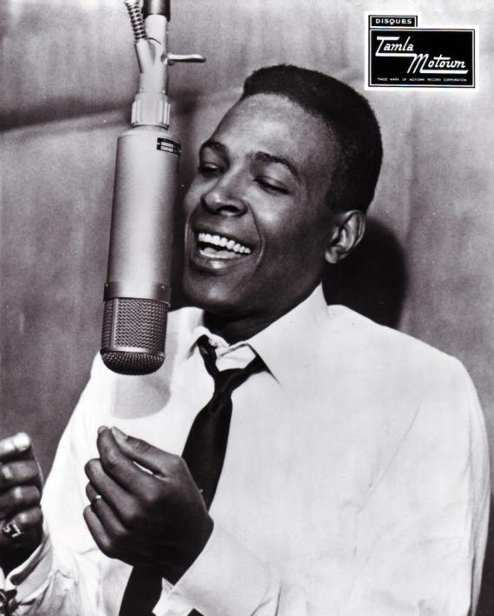
Social and political meaning
Even Motown records, who had deliberately avoided the soul sound and songs with social meaning got into the act.
Marvin Gaye’s (pictured right) ‘What’s Going On’ became a powerful anthem calling for peace and understanding.
Getty Images/Redferns/Gilles Petard

Slide 15
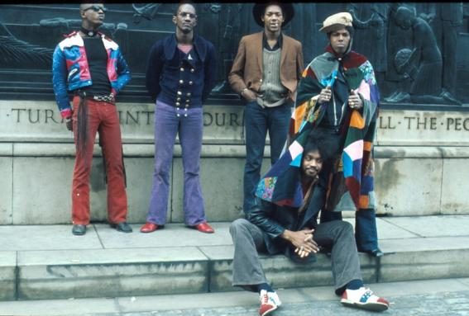
Funk
By the 1970s, the strong emphasis on the rhythmic groove in soul had evolved even further into funk, thanks largely to George Clinton and his bands Funkadelic (pictured right) / Parliament.
Getty Images/Michael Ochs Archives

Slide 16
Disco
Funk emphasised the first beat in the bar, complex syncopated internal polyrhythms, strong bass lines and a blues feel. A simplified form became commercially success as disco. Disco music dominated the dance floors from the mid-1970s on. Dance-based blues had returned to popular music, albeit in different forms.

