Slide 1
Chapters 3 and 4
The British Invasion and folk protest music

Slide 2
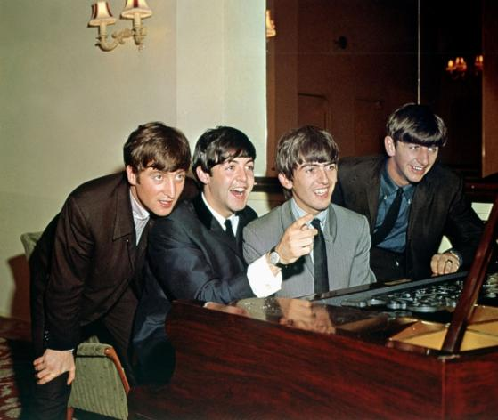
The Beatles
Britain had also caught the rock’n’roll bug in the 1950s, but unlike America where record companies deliberately tamed the music, British artists kept writing fast fun dance music, known as beat music. One of the most successful beat bands was the Beatles.
Alamy/AF archive

Slide 3
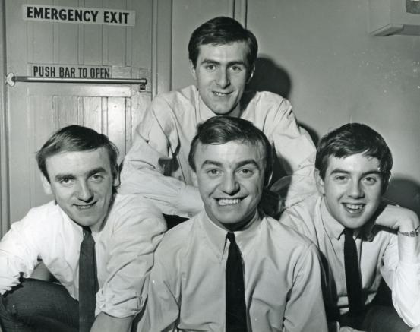
The British Invasion
The Beatles’ record company didn’t think their music would be popular in America, but after pressure started releasing their songs from 1964 to massive success. This opened the way for other British bands to follow, including Gerry & the Pacemakers, in what was called ‘The British Invasion’.
Alamy/Pictorial Press Ltd

Slide 4
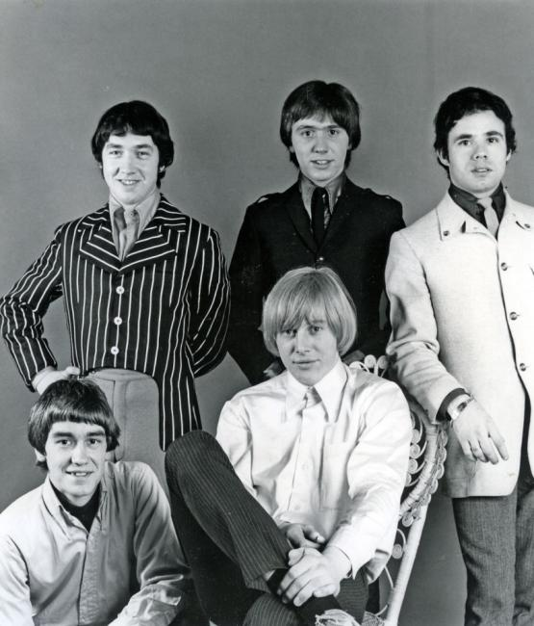
The Easybeats
Australian artists also caught the ‘beat boom bug’ and wrote songs in the style of the Beatles. One of the most successful was the Easybeats, who travelled to the Britain to record their landmark song ‘Friday on my Mind’ with the Beatles’ producer, George Martin.
Alamy/Pictorial Press Ltd

Slide 5
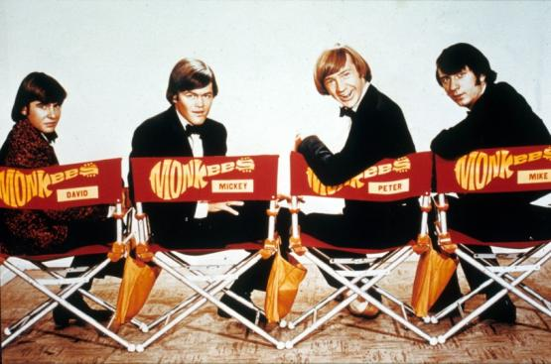
The American response
Some American artists were jealous of the success of the British bands and tried to copy or compete with them.
One band, the Monkees, was created by a TV studio, for a TV series about the antics of a ‘zany’ pop group in imitation of the Beatles.
Alamy/Moviestore collection Ltd

Slide 6
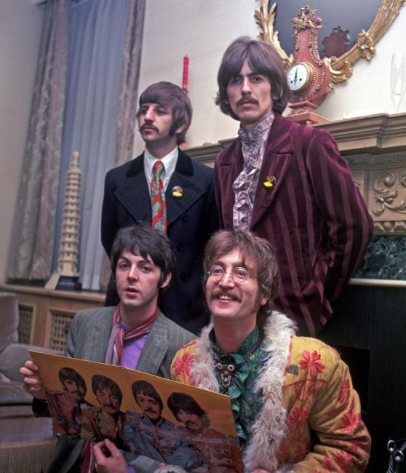
The Beatles’ later music
As the Beatles matured, so their music and image changed. They were heavily influenced by the music of Bob Dylan, and by Indian spiritualism.
One of their later songs, ‘Lucy in the Sky with Diamonds’, generated controversy over its lyrics.
Alamy/Pictorial Press Ltd

Slide 7
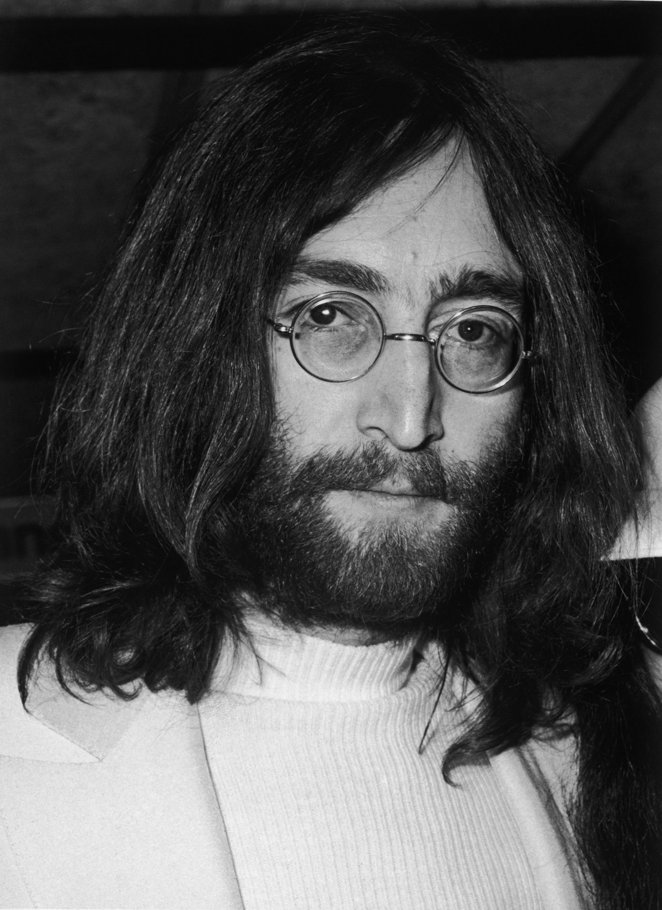
The Beatles – solo careers
The Beatles broke up in 1970 and each member went on to have successful solo careers.
One of the most successful and controversial was John Lennon. His song ‘Imagine’ has been adopted as the theme song for Amnesty International.
Getty Images/Hulton Archive

Slide 8
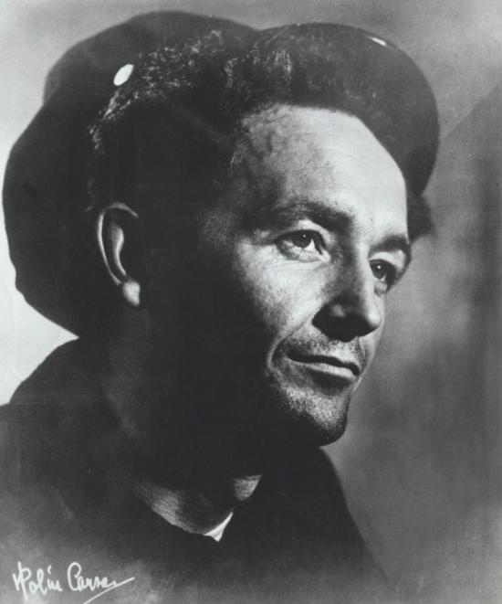
Folk protest music
The early 1960s also saw the rise of folk protest music in America. These songs were largely acoustic and sung by singer-songwriters.
The tradition of singing songs about social issues was popularised from the 1930s by Woody Guthrie.
Corbis/John Springer Collection

Slide 9
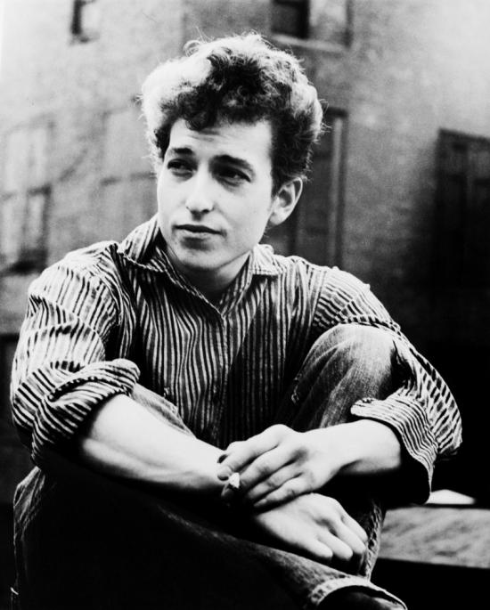
Bob Dylan
Guthrie’s simple protest song tradition was carried on by Pete Seegar, Joan Baez and others, but arguably the most successful was Bob Dylan.
Dylan wrote many songs with poetic lyrics which are still regarded as classics, such as ‘Blowin’ in the Wind.’
Corbis/Bettmann

Slide 10
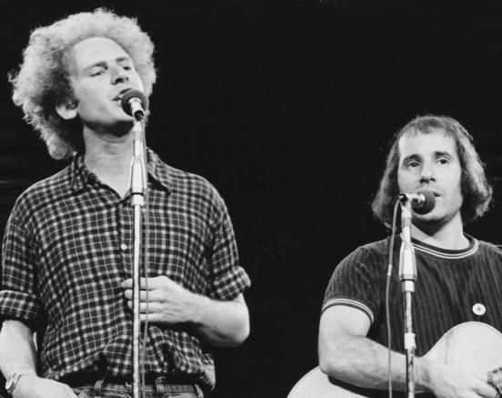
Simon and Garfunkel
Others followed, including the very successful duo Simon and Garfunkel. They crafted poetic lyrics with delicate and intricate harmonies to produce gentle but powerful folk-inspired songs, such as the anti-war ‘Scarborough Fair’, ‘Sounds of Silence’ and ‘Bridge over Troubled Water’.
Getty Images/Redferns/Douglas R. Gilbert

Slide 11
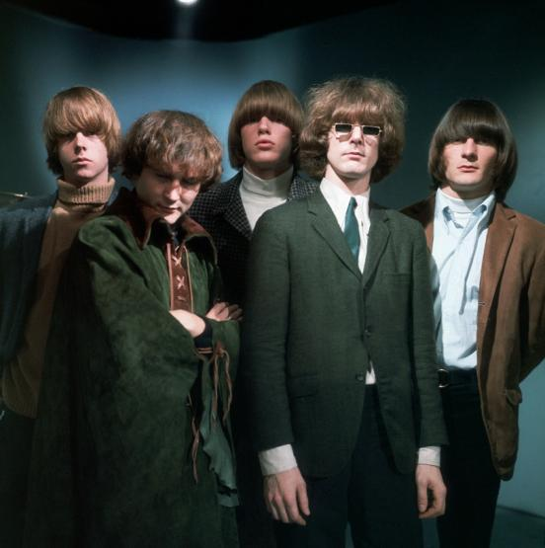
Folk rock
In 1964, Dylan realised he could reach a bigger audience through rock, so appeared onstage at the Newport Festival playing electric guitar.
Despite being booed off the stage, he inspired a new musical genre called folk rock. An early folk rock band was Buffalo Springfield.
Corbis/Hulton-Deutsch Collection

Slide 12
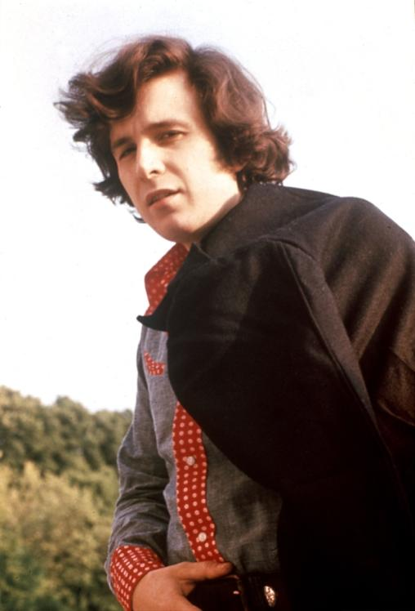
American Pie
One of the most successful folk rock artists was Don McLean. His cryptic autobiographical song ‘American Pie’ has kept generations guessing as to the true meaning of its lyrics.
Alamy/Pictorial Press Ltd

Slide 13
Australian folk music
Australia has also enjoyed a tradition of folk protest songs dating back to the nineteenth century. Australian bands also embraced folk rock.
One of the most powerful and enduring songs was ‘I Was Only Nineteen’ by Redgum. The song described the despair of a returned Vietnam War veteran.
© News Limited/The Messenger archive, courtesy of State Library of South Australia [B70869/15451]

Slide 14

Australian songwriters
More recently, bands such as the Waifs have maintained the folk rock tradition. They have been popular with both folk and mainstream rock audiences.
Getty Images/Redferns/Martin Philbey

Slide 15
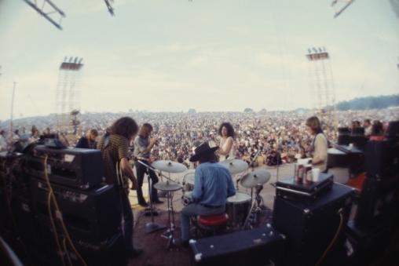
Psychedelic rock
The folk rock movement was integral to the hippie culture of the late 1960s. Unfortunately, widespread drug usage gave rise to psychedelic rock, and a number of famous artists died from overdoses. However, the movement culminated in the Woodstock Festival in 1969.
Getty Images/Time Life Pictures/Bill Eppridge

Slide 16
Summary
The British Invasion helped revitalise popular music, and folk rock added a new dimension. Both styles demonstrated the growing diversification of popular music.

