Slide 1
Chapters 1 and 2
Rock’n’roll and Teen pop

Slide 2
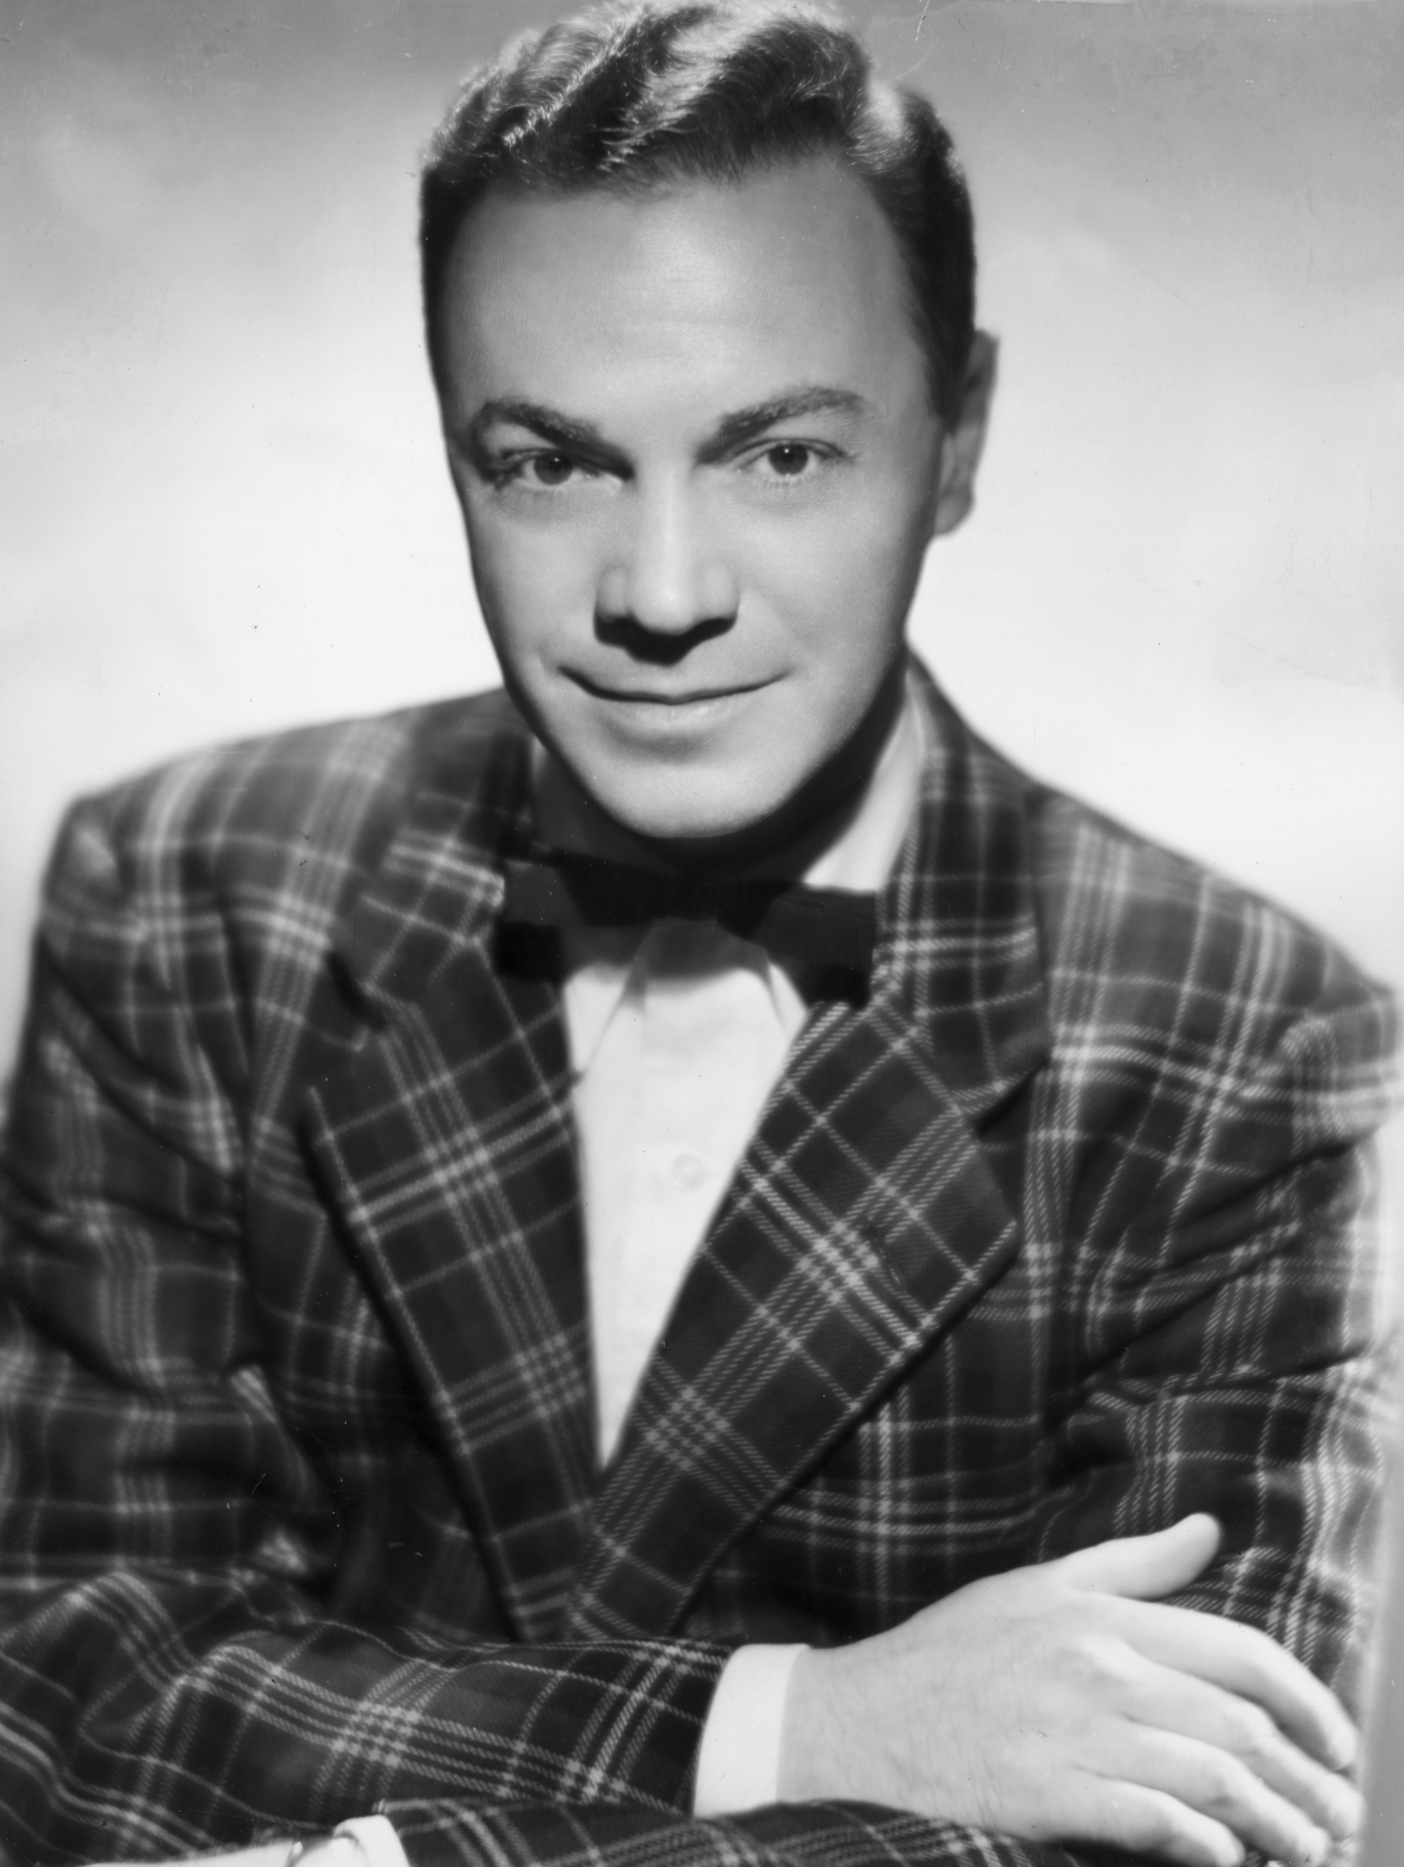
The rock’n’roll explosion
Rock’n’roll was a musical and cultural phenomenon that exploded in America from 1954. The sound of rock’n’roll derived from rhythm and blues, popular among African Americans from the 1940s, but considered inappropriate by white audiences.
The music had a fast dance beat and DJ Alan Freed saw how teenagers responded to it, and began promoting it on his radio program, the Moondog Show.
Getty Images/Hulton Archive

Slide 3
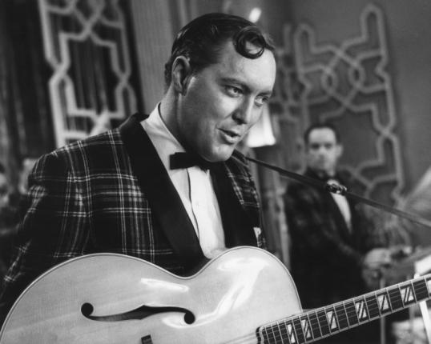
Bill Haley
Bill Haley was a country music artist who picked up on the popularity of rhythm and blues. With his backing band, the Comets, he re-recorded an older blues song called ‘Rock Around the Clock’.
The song went on to become a bestseller and is regarded as the first rock’n’roll hit.
Corbis/Michael Ochs Archives

Slide 4
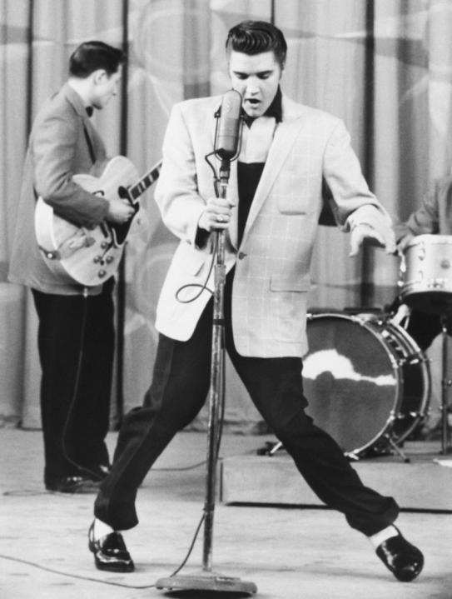
Elvis Presley
However, it is Elvis Presley who really sold rock’n’roll to white audiences. With his country style vocals, energetic performances, good looks and provocative moves, he shocked the older generation but the kids loved him. He was christened ‘the king’ by his fans, and ‘Elvis the pelvis’ by his detractors.
Corbis/Bettmann

Slide 5
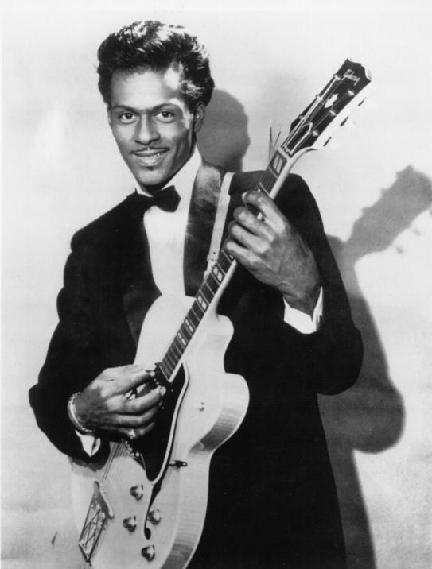
Chuck Berry
The rock’n’roll sound was pioneered by Chuck Berry. A guitarist, he introduced many techniques which became standard in rock’n’roll, and introduced teenage lyrics in songs such as ‘Johnny B Goode’.
Many regard him as the true father of rock’n’roll.
Alamy/Granamour Weems Collection

Slide 6
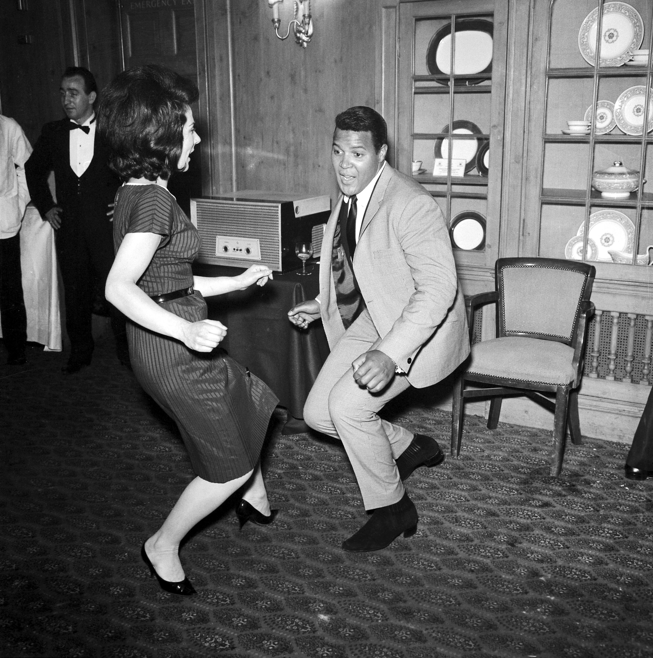
Rock’n’roll culture
Rock’n’roll music helped give rise to a new cultural movement for young people. Central to this was dancing, with new steps such as the Twist (pictured right), Fish, Bird, Monkey, Alligator, Swim, Boney Maroney and many more becoming very popular, and spread by public music machines known as Jukeboxes.
Getty Images/Hulton Archive

Slide 7
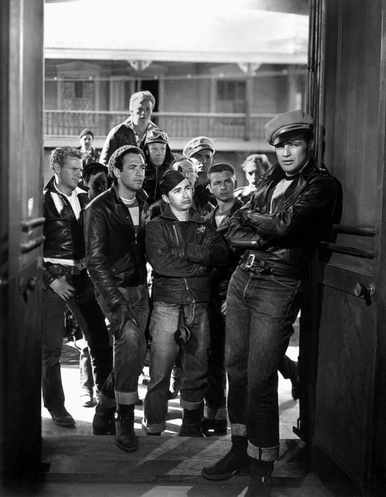
Rock’n’roll fashion
Rock’n’roll also influenced the way young people dressed, with leather jackets, white t-shirts and blue jeans becoming the fashion for rebellious young men.
Alamy/AF archive/Columbia

Slide 8
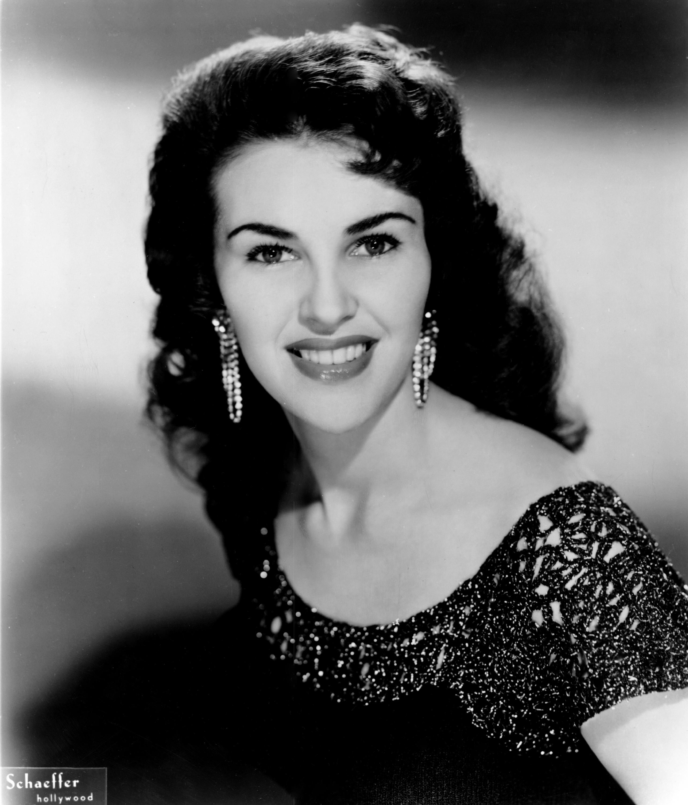
Women in rock’n’roll
Female singers such as Wanda Jackson also tried to join the rock craze, but with American society struggling to cope with this wild, infectious and rebellious music for young people, the world just wasn’t ready yet for female rockers.
Getty Images/Michael Ochs Archives

Slide 9
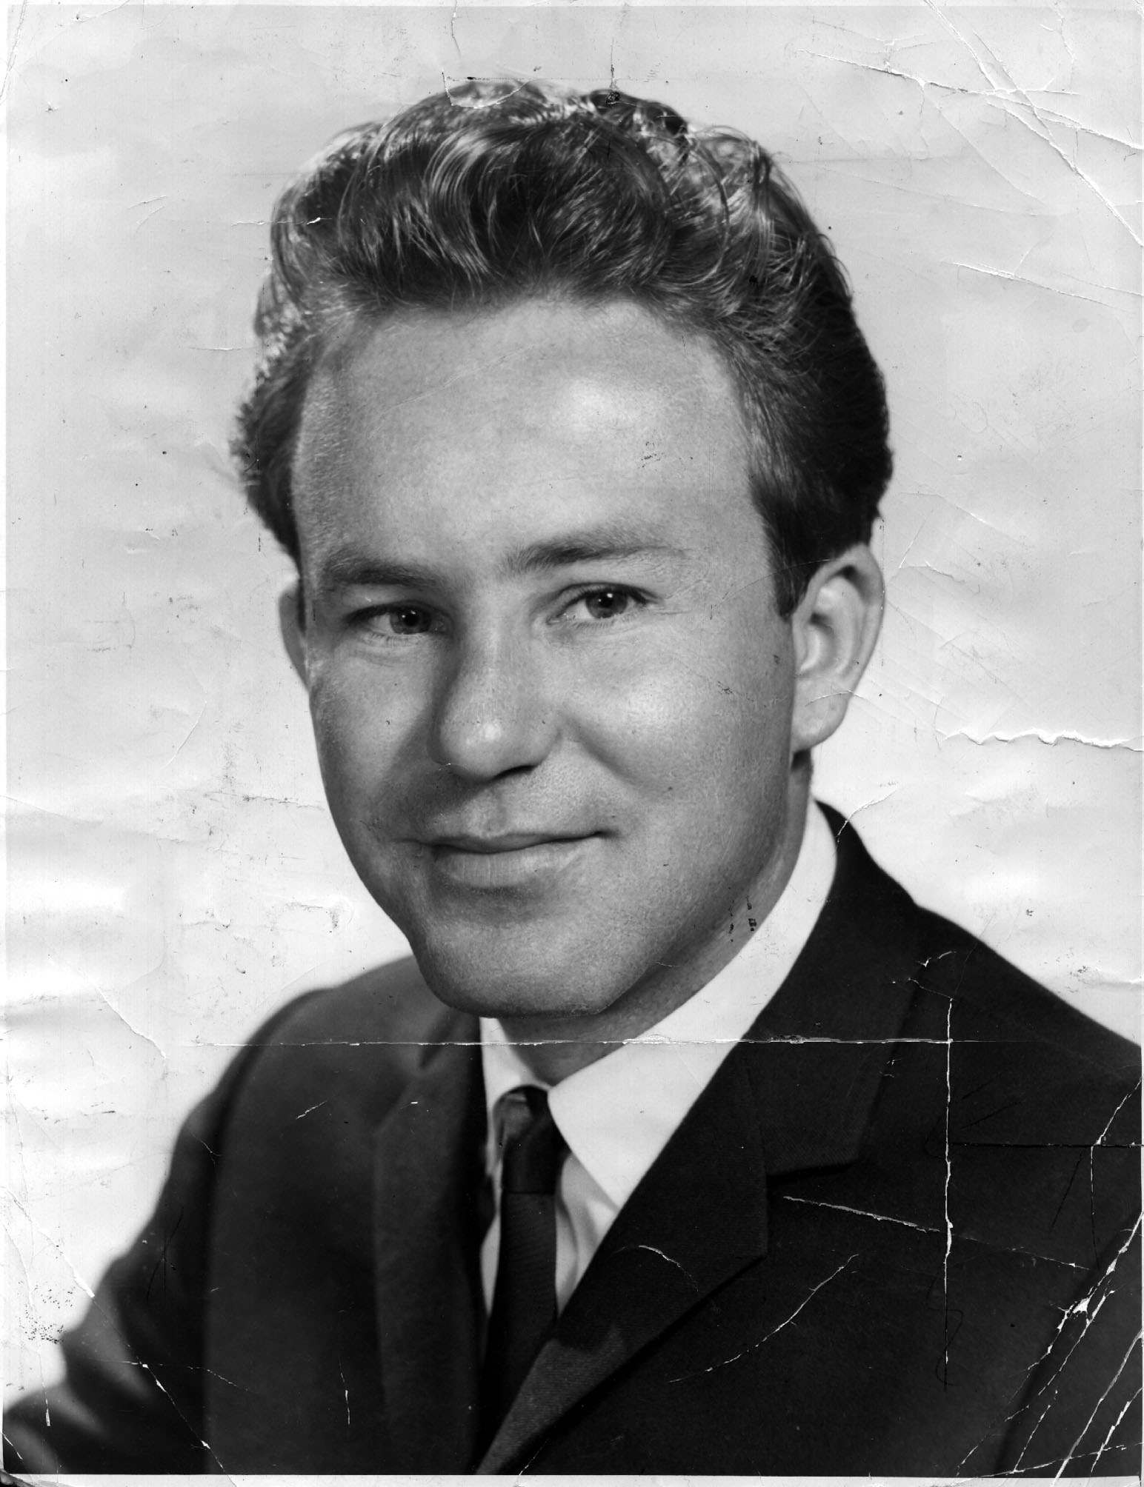
Australian rock’n’roll artists
Australia also caught the rock’n’roll bug from 1955. After struggling for recognition, Johnny O’Keefe eventually emerged as Australia’s number one rock artist, and our very own ‘king of rock’.
Newspix/News Ltd

Slide 10
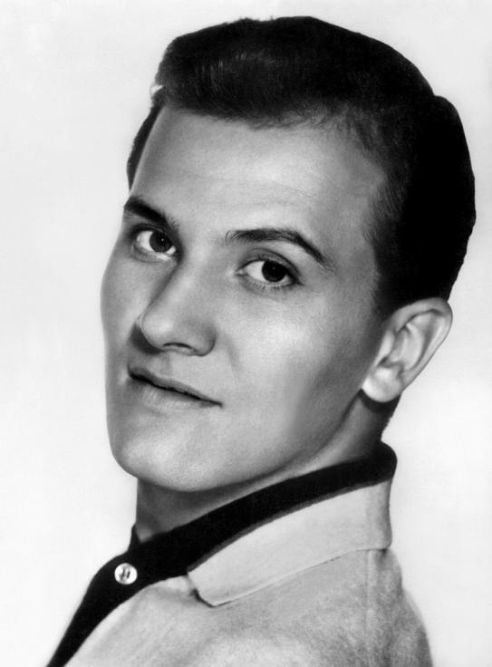
Teen pop
The record companies became increasingly scared of the musical monster they had unleashed, and they tried to reform popular music from the late 1950s.
They introduced manufactured teen idols (such as Pat Boone, right), slowed the music down and changed song lyrics to ‘safe’ topics such as romance.
Alamy/AF archive

Slide 11
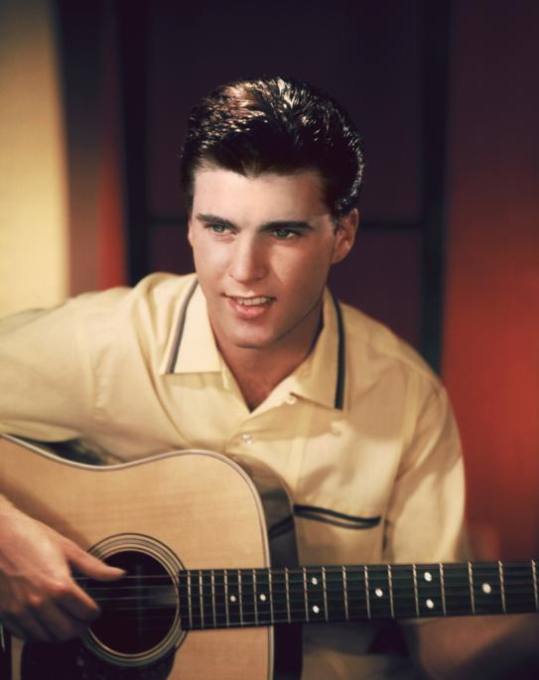
Teenage dreams
Many of the teen idols were hired for their looks as much as their musical ability, and were created specifically to appeal to young girls.
Stars such as Ricky Nelson (right) sang about teenage dreams of finding the perfect partner.
Getty Images/Hulton Archive

Slide 12
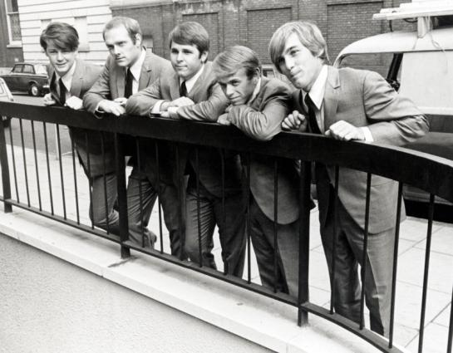
Beach culture
Teen pop also coincided in the early 1960s with the birth of beach culture. The beach culture, which celebrated sun and surf and centred in California, gave rise to the surf sound, epitomised by bands such as the Beach Boys in songs such as ‘Good Vibrations’.
Alamy/Pictorial Press Ltd

Slide 13
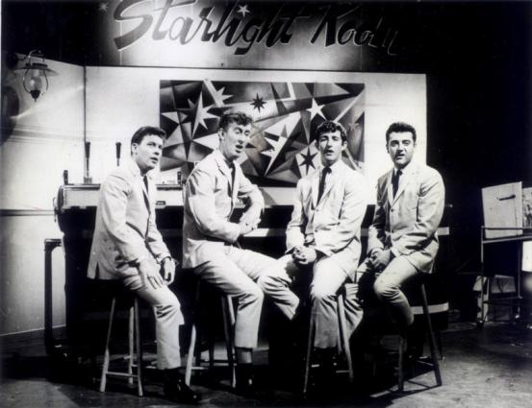
Australian beach culture
The beach culture was also very popular in Australia, and gave rise to Australian groups such as the Delltones, who are still performing today.
Newspix/News Ltd

Slide 14
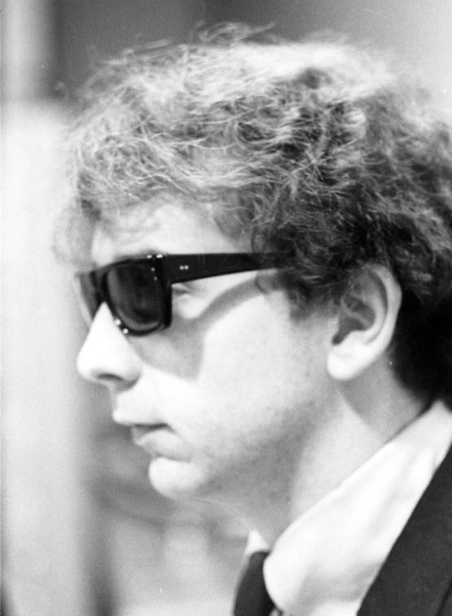
Phil Spectre
One of the most successful record producers of teen pop was Phil Spectre. He used lots of instruments to back his singers, and added lots of reverb to his recordings to produce a lush, thick sound known as the ‘wall of sound’. He called his songs ‘symphonies for little kids.’
Getty Images/Hulton Archive

Slide 15
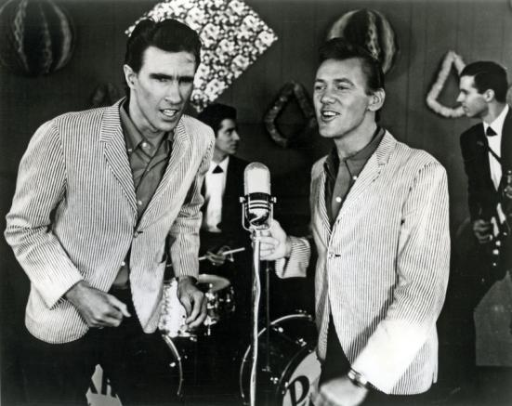
The ‘wall of sound’
One of Spectre’s most successful groups was the Righteous Brothers. The ‘wall of sound’ is most evident in their song ‘Unchained Melody’.
Alamy/Pictorial Press Ltd

Slide 16
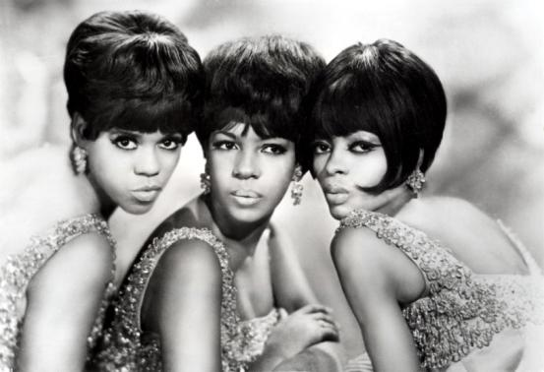
Motown
Around the same time in Detroit, Berry Gordy established Motown Records. Motown Records was set up by African Americans to record and promote African American artists.
Slickly produced and often featuring doo-wop style backing vocals, Motown enjoyed huge success with acts such as the all-girl group, the Supremes, led by Diana Ross.
Alamy/Pictorial Press Ltd

Slide 17
The next phase
From its explosive start as rebellious teenage dance music in the early 1950s, popular music had changed considerably by the early 1960s. It had lost much of its energy and importantly its dance beat. Many critics described the music as polished but bland. The stage was set for dramatic developments from 1964.

